Slide 1



MATH 4995 Project 2: Pawpularity Prediction Using Machine Learning with Tabular Metadata and Images
Presenter: SHAO Zhihao
Date: 11/23/2021

Slide 2
Table of Contents:
Introduction
Dataset Description: PetFinder.my
Exploratory Data Analysis
Regression with Tabular metadata
Swin Transformer with Image data
Analysis

Slide 3
Table of Contents:
Introduction
Dataset Description: PetFinder.my
Exploratory Data Analysis
Regression with Tabular metadata
Swin Transformer with Image data
Analysis

Slide 4

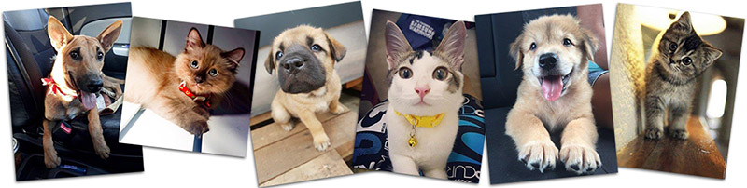
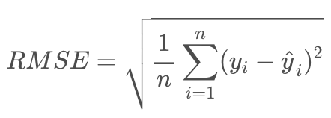
Introduction:
Millions of stray animals suffer on the streets or are euthanized in shelters every day around the world. You might expect pets with attractive photos to generate more interest and be adopted faster.
PetFinder.my is Malaysia’s leading animal welfare platform, featuring over 180,000 animals with 54,000 happily adopted. PetFinder collaborates closely with animal lovers, media, corporations, and global organizations to improve animal welfare.
But what makes a good picture?
With the help of data science, you may be able to accurately determine a pet photo’s appeal and even suggest improvements to give these rescue animals a higher chance of loving homes.
Evaluation metric:
Notes:
In this competition, you’ll analyze raw images and metadata to predict the “Pawpularity” of pet photos. You'll train and test your model on PetFinder.my's thousands of pet profiles. Winning versions will offer accurate recommendations that will improve animal welfare.

Slide 5
Table of Contents:
Introduction
Dataset Description: PetFinder.my
Exploratory Data Analysis
Regression with Tabular metadata
Swin Transformer with Image data
Analysis

Slide 6
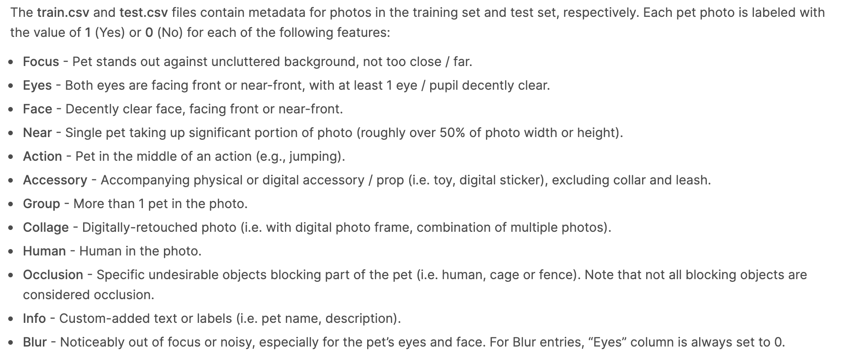
Dataset Description:
Photo metadata:
Manually labeling each photo for key visual quality and composition parameters
12 predictors
Notes:
Due to the time limit, in this project I only used the main application training and testing data, which means that the models presented later were trained on incomplete data. The result here is just a baseline prototype that we can then improve upon.

Slide 7
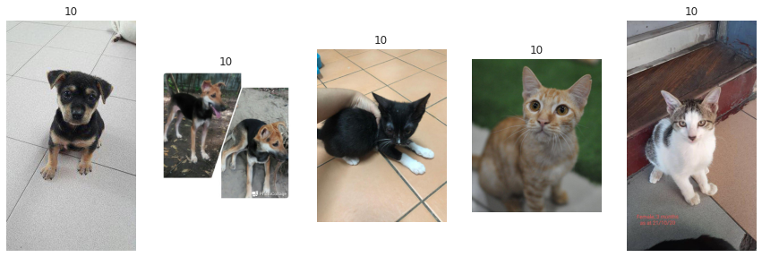
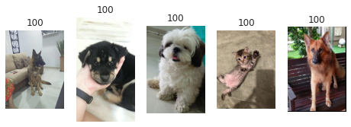
Dataset Description:
Image data:
The training data contains 9912 pictures in total, each with a pawpularity score.
The Pawpularity Score is derived from each pet profile‘s page view statistics at the listing pages
Notes:
Due to the time limit, in this project I only used the main application training and testing data, which means that the models presented later were trained on incomplete data. The result here is just a baseline prototype that we can then improve upon.

Slide 8
Table of Contents:
Introduction
Dataset Description: PetFinder.my
Exploratory Data Analysis
Regression with Tabular metadata
Swin Transformer with Image data
Analysis

Slide 9
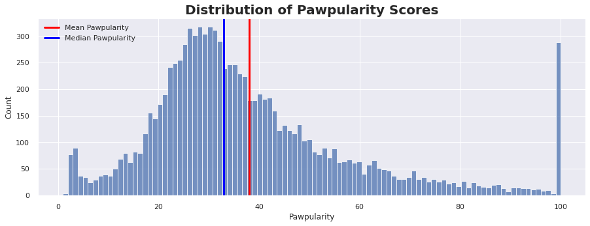
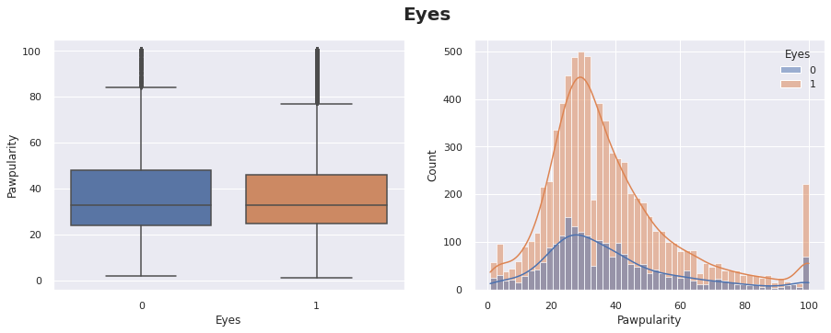
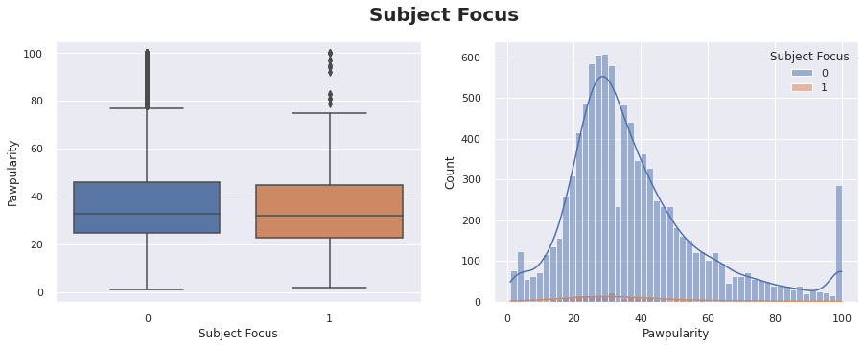
Exploratory Data Analysis:
Photo metadata
Response variable – Pawpularity score:
The distribution of target variable – pawpularity score is slight skewed to the left, and plenty of samples have 100 score.
Predictors:
The distribution of pawpularity score is similar for each predictor and class
(Changing the features doesn't seem to influence the pawpularity scores that much)
Notes:
Imbalanced distribution of response variable

Slide 10
Table of Contents:
Introduction
Dataset Description: PetFinder.my
Exploratory Data Analysis
Regression with Tabular metadata
Swin Transformer with Image data
Analysis

Slide 11
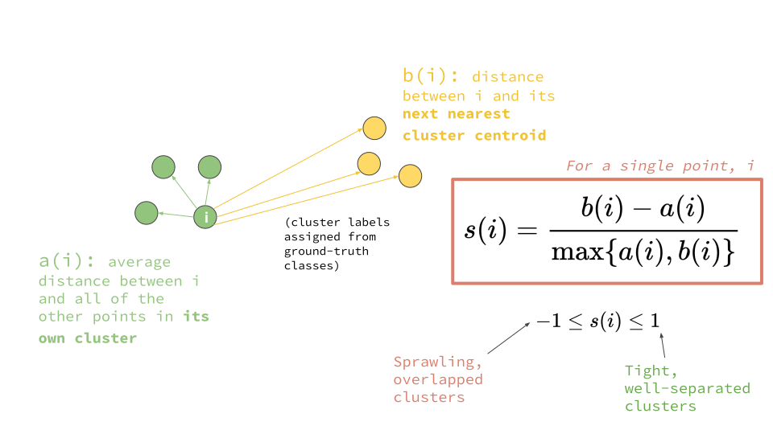
Regression with Tabular Metadata:
Feature Engineering
Add normalized size and shape of images
Normalized by MinMaxScaler
Add K-means clustering results
K = 8 by Silhouette score
Add PCA features
Top 15 PCA features explained about 100% variance
Model Selection
Random Forest
Light Gradient Boosting Machine (GBM)
Voting regression – Ensemble method
Notes:
The reason why I chose these workflow is that I want to try such ensemble method to leverage the combination of "weak" learners and they can report feature importance for better interpretation.

Slide 12
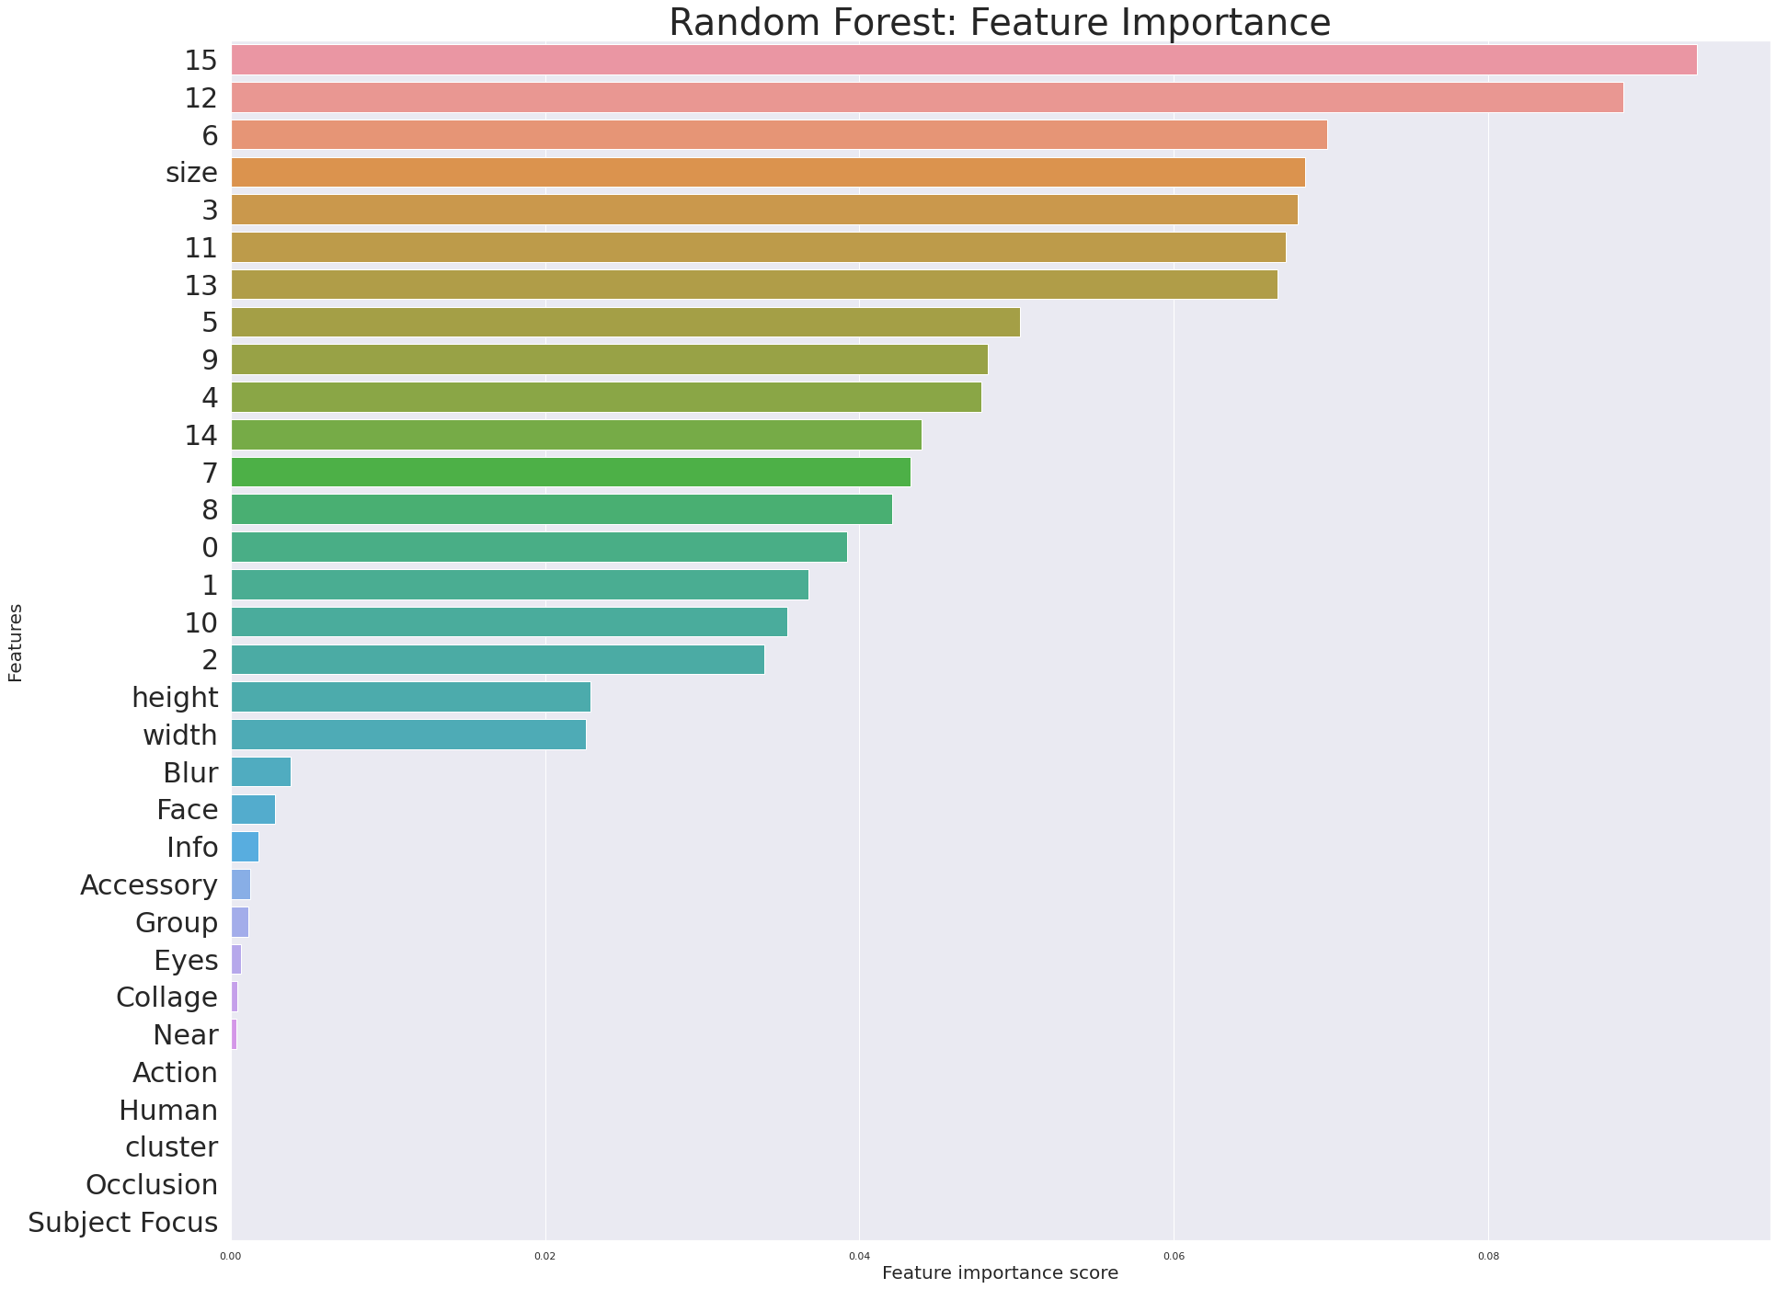
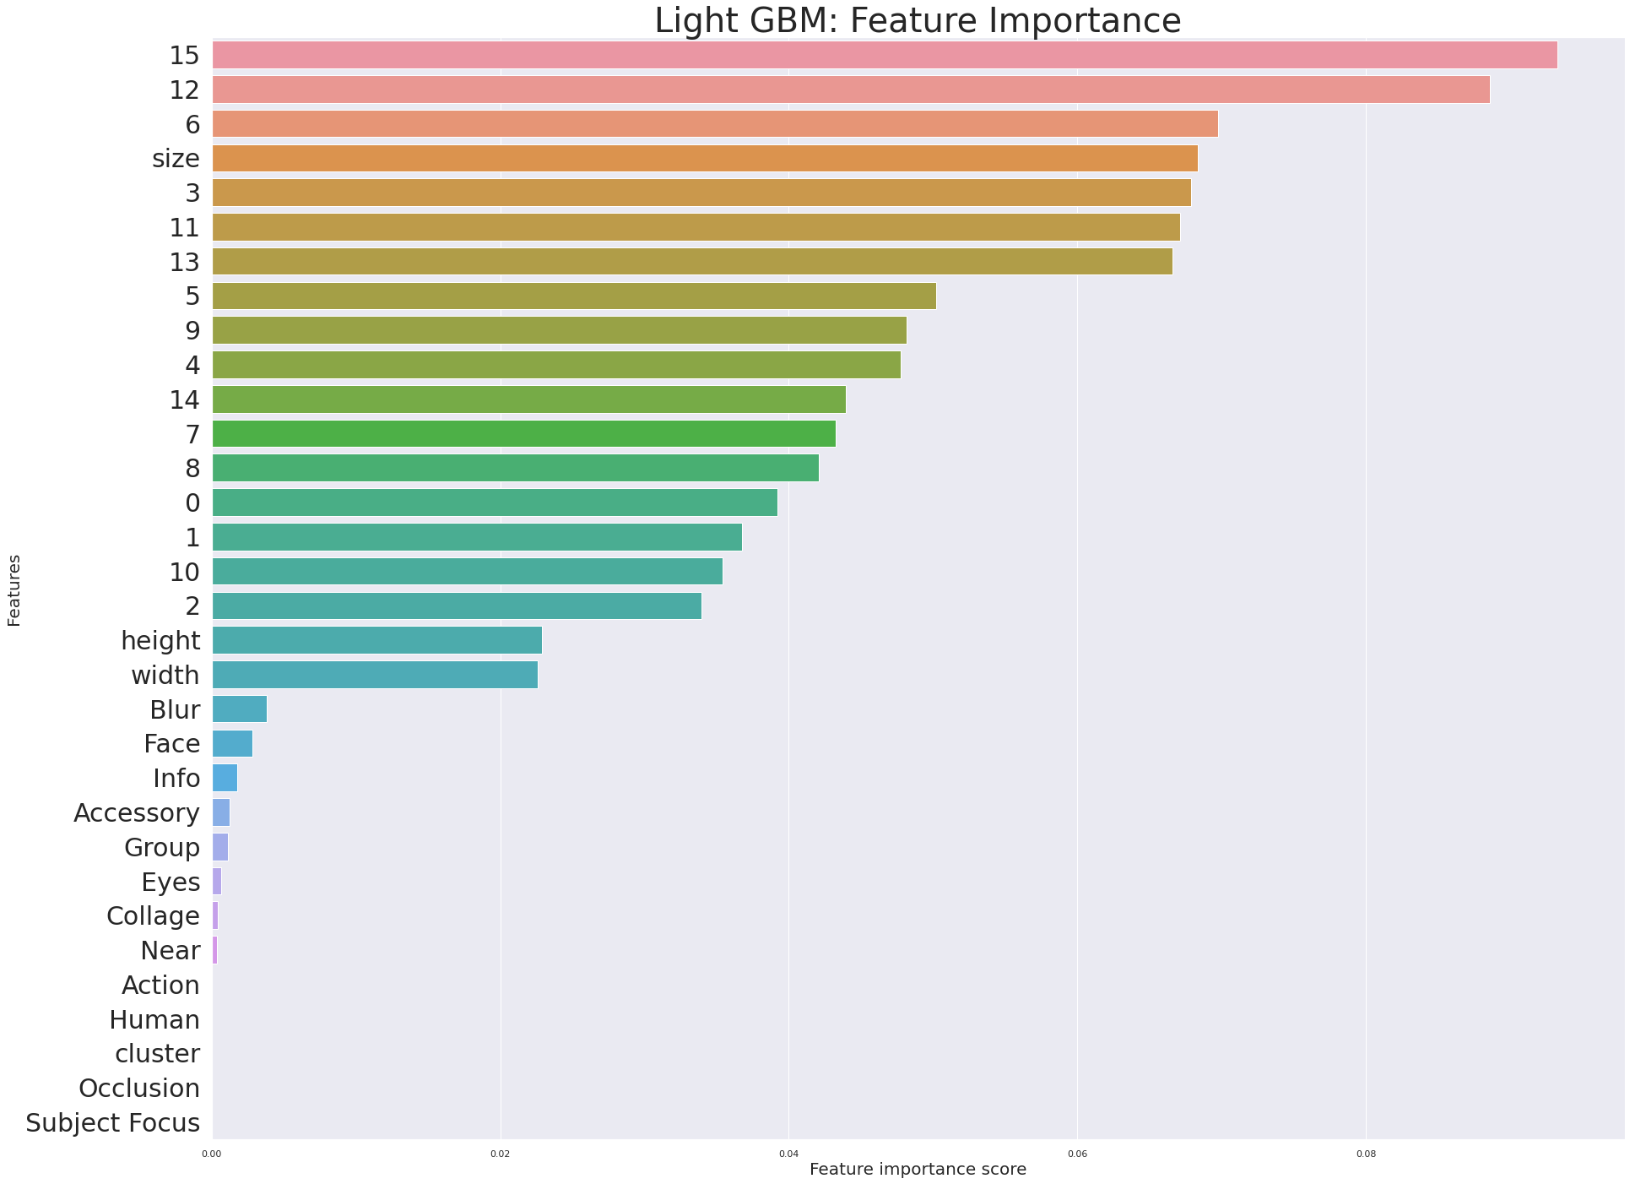
Regression with Tabular Metadata:
Hyperparameter tuning
Method: Five-fold cross validation
Equally weighted for voting regression
Model | Random Forest | Light GBM
Feature Importance
Notes:
The reason why I chose these workflow is that I want to try such ensemble method to leverage the combination of "weak" learners and they can report feature importance for better interpretation.

Slide 13
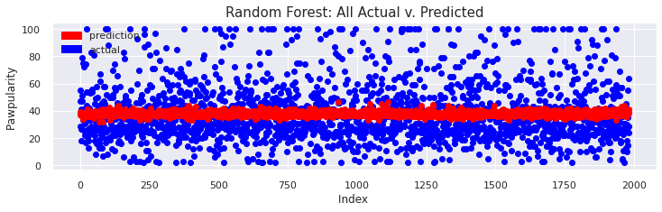
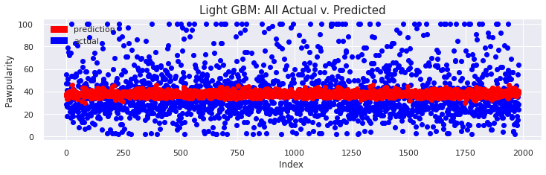
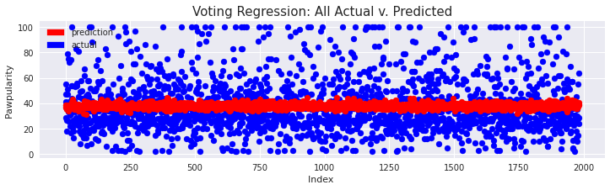
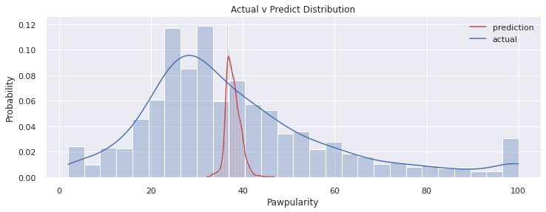
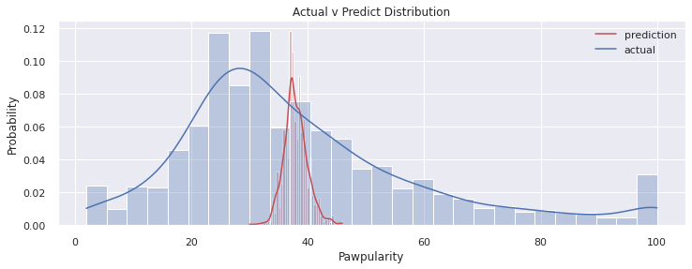
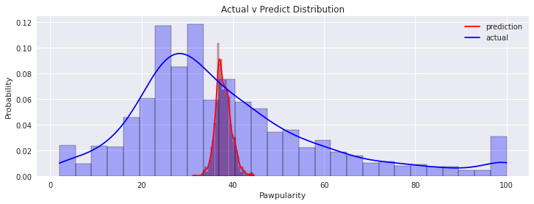
Regression with Tabular Metadata:
Results
Model | Random Forest | Light GBM | Voting Regression
RMSE (test split) | 20.787 | 20.725 | 20.746
Prediction v.s. Actual scores
Notes:
The reason why I chose these workflow is that I want to try such ensemble method to leverage the combination of "weak" learners and they can report feature importance for better interpretation.

Slide 14
Table of Contents:
Introduction
Dataset Description: PetFinder.my
Exploratory Data Analysis
Regression with Tabular metadata
Swin Transformer with Image data
Analysis

Slide 15
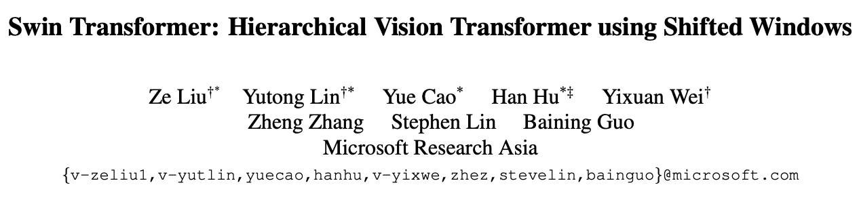
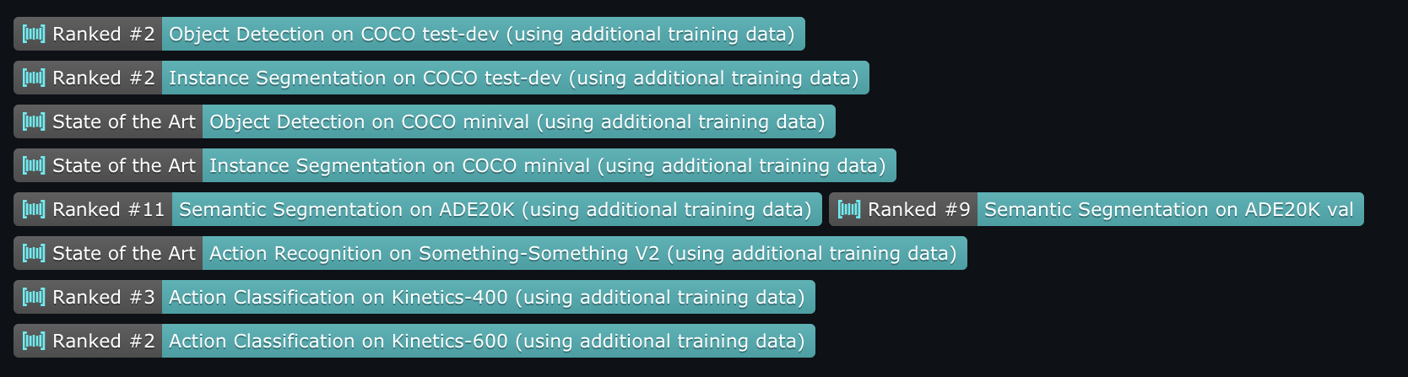
Swin Transformer:
ICCV 2021 best paper award
https://arxiv.org/pdf/2103.14030.pdf
Notes:
The EDA suggests that most original features show weak correlation (absolute value < 0.1) with the response variable. In order to reduce the dimensionality, I conducted PCA analysis and extracted top 40 components which can explain about 80% of the data variance. Furthermore, 16 predictors with highest correlations were selected.

Slide 16
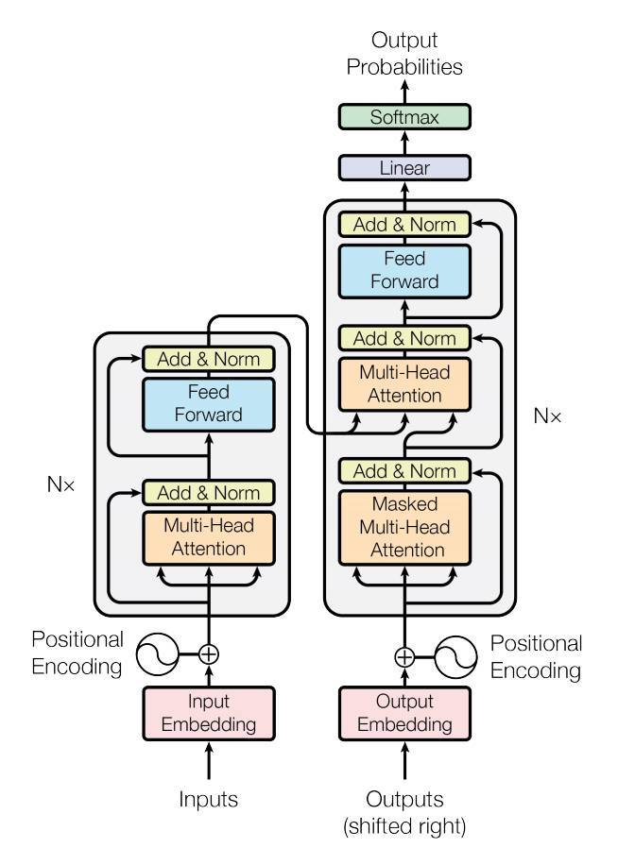

Swin Transformer:
Disadvantages of Transformers for image data:
Unlike word tokens in NLP, visual elements have various scales. Especially in object detection;
Images are in much higher resolution and vision tasks that require pixel-level predictions are intractable for transformers because the computation complexity(+memory usage) of self-attention is quadratic to image size.
Transformer
VS
CNN
Notes:
The EDA suggests that most original features show weak correlation (absolute value < 0.1) with the response variable. In order to reduce the dimensionality, I conducted PCA analysis and extracted top 40 components which can explain about 80% of the data variance. Furthermore, 16 predictors with highest correlations were selected.

Slide 17
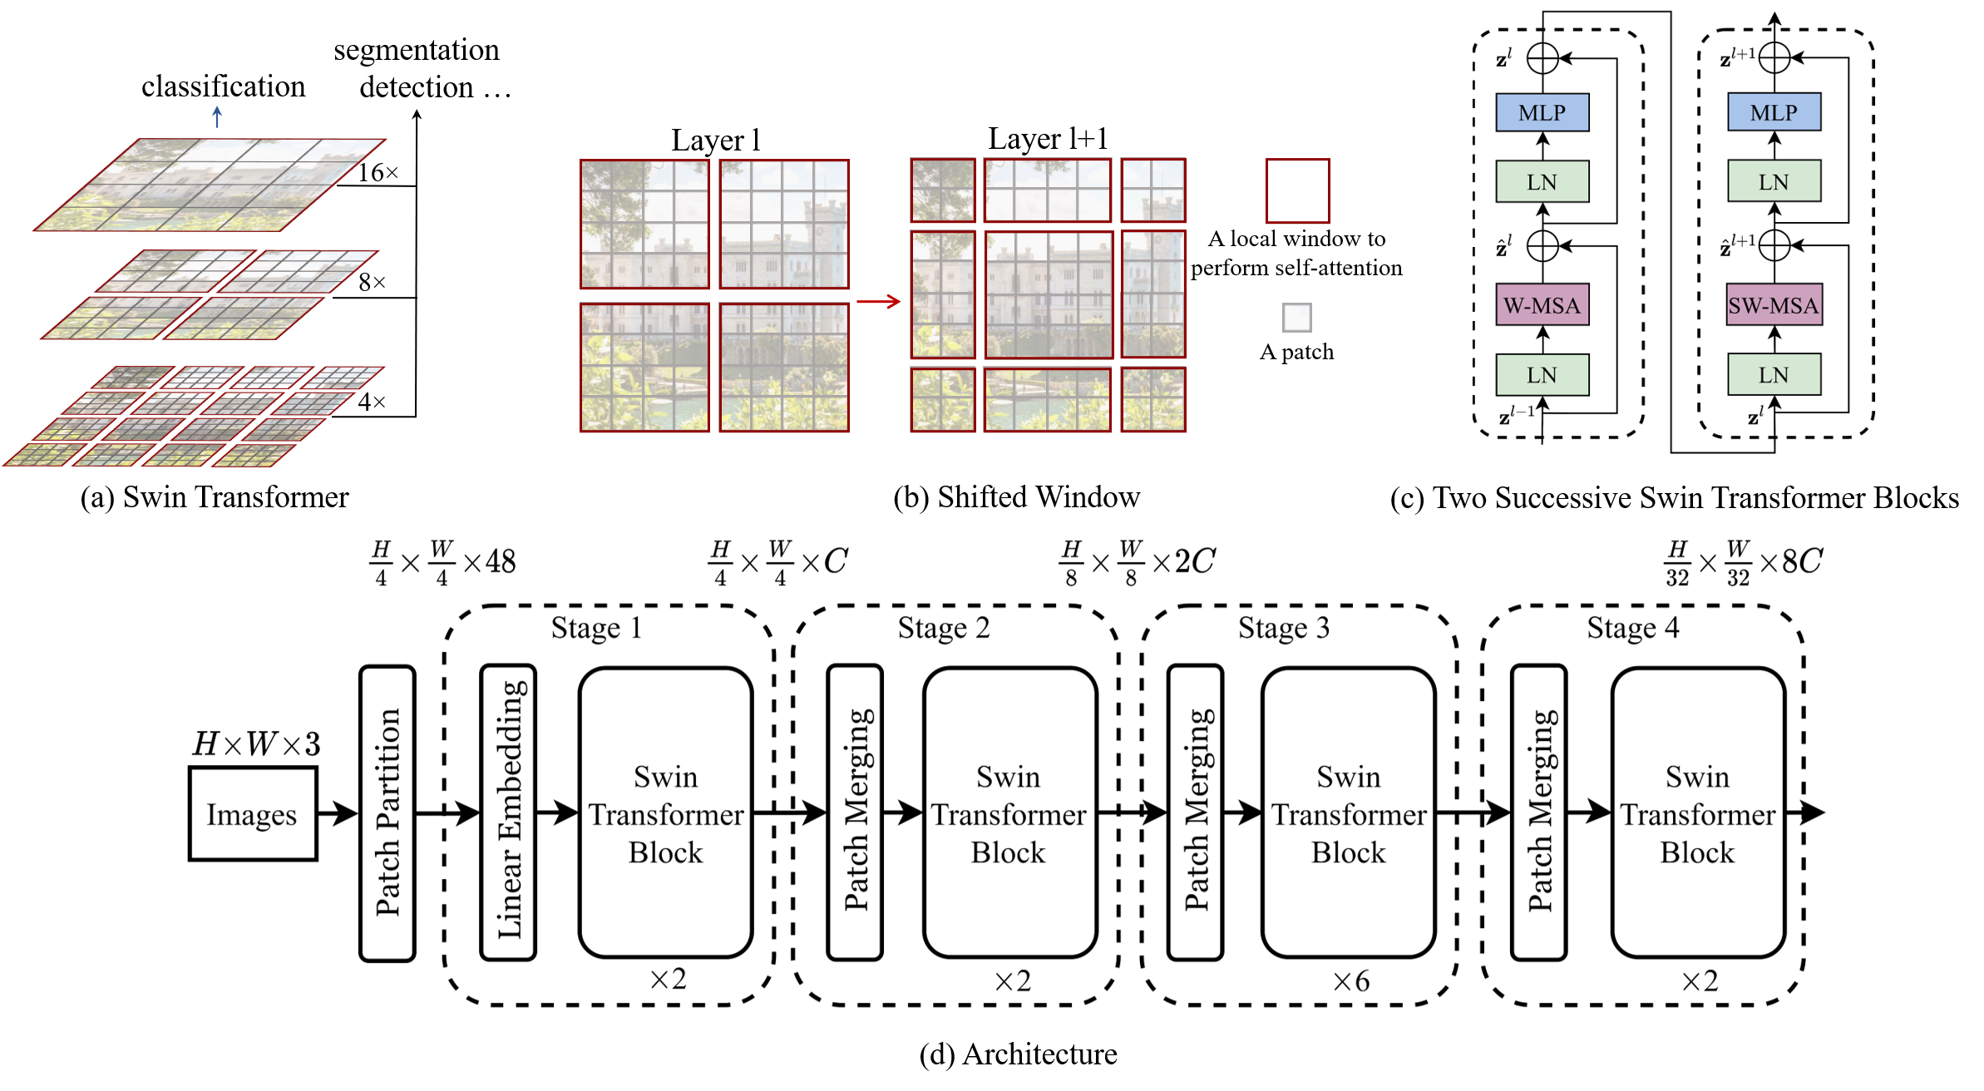
Swin Transformer:
Novelties

Slide 18
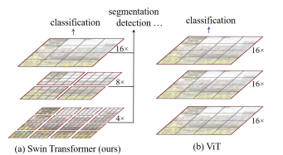
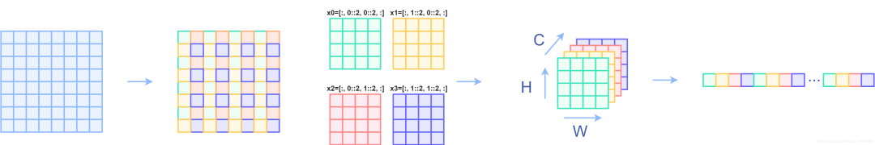
Swin Transformer:
Hierachical Representation
- Detect objects of various scales efficiently
The number of tokens is reduced by patch merging layers which concatenates the features of 2 × 2 neighboring patches as the network gets deeper.
In contrast, previous vision Transformers produce feature maps of a single low resolution.
Patch merging layers in Transformer ⬄ Pooling in CNN
https://cloud.tencent.com/developer/article/1819813
Notes:
It first splits an input RGB image into non-overlapping patches by a patch splitting module, like ViT. Each patch is treated as a “token” and its feature is set as a concatenation of the raw pixel RGB values. In our implementation, we use a patch size of 4 × 4 and thus the feature dimension of each patch is 4 × 4 × 3 = 48. A linear embedding layer is applied on this raw-valued feature to project it to an arbitrary dimension (denoted as C). Several Transformer blocks with modified self-attention computation (Swin Transformer blocks) are applied on these patch tokens. The Transformer blocks maintain the number of tokens ( H 4 × W 4 ), and together with the linear embedding are referred to as “Stage 1”.
To produce a hierarchical representation, the number of tokens is reduced by patch merging layers as the network gets deeper. The first patch merging layer concatenates the features of each group of 2 × 2 neighboring patches, and applies a linear layer on the 4C-dimensional concatenated features. This reduces the number of tokens by a multiple of 2×2 = 4 (2× downsampling of resolution), and the output dimension is set to 2C. Swin Transformer blocks are applied afterwards for feature transformation, with the resolution kept at H 8 × W 8 . This first block of patch merging and feature transformation is denoted as “Stage 2”. The procedure is repeated twice, as “Stage 3” and “Stage 4”, with output resolutions of H 16 × W 16 and H 32 × W 32 , respectively. These stages jointly produce a hierarchical representation,

Slide 19
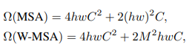
Swin Transformer:
Shifted-Window Multi-head Self-Attention (SW-MSA)
- Lower computation complexity
The shifted window aims to compute self-attention within local windows.
During the Swin transformer blocks, the network alternates between standard window configuration(W-MSA) and shited window configuration(SW-MSA).
This approach introduces connections between neighboring overlapping windows just like how deep convolutions work.
4 windows -> 9 windows
Notes:
It first splits an input RGB image into non-overlapping patches by a patch splitting module, like ViT. Each patch is treated as a “token” and its feature is set as a concatenation of the raw pixel RGB values. In our implementation, we use a patch size of 4 × 4 and thus the feature dimension of each patch is 4 × 4 × 3 = 48. A linear embedding layer is applied on this raw-valued feature to project it to an arbitrary dimension (denoted as C). Several Transformer blocks with modified self-attention computation (Swin Transformer blocks) are applied on these patch tokens. The Transformer blocks maintain the number of tokens ( H 4 × W 4 ), and together with the linear embedding are referred to as “Stage 1”.
To produce a hierarchical representation, the number of tokens is reduced by patch merging layers as the network gets deeper. The first patch merging layer concatenates the features of each group of 2 × 2 neighboring patches, and applies a linear layer on the 4C-dimensional concatenated features. This reduces the number of tokens by a multiple of 2×2 = 4 (2× downsampling of resolution), and the output dimension is set to 2C. Swin Transformer blocks are applied afterwards for feature transformation, with the resolution kept at H 8 × W 8 . This first block of patch merging and feature transformation is denoted as “Stage 2”. The procedure is repeated twice, as “Stage 3” and “Stage 4”, with output resolutions of H 16 × W 16 and H 32 × W 32 , respectively. These stages jointly produce a hierarchical representation,

Slide 20
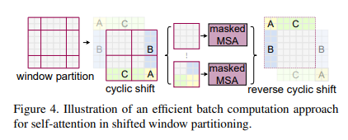
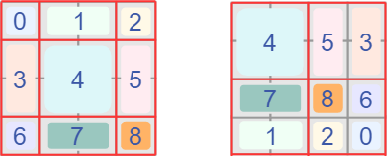
Swin Transformer:
Efficient shifting
- Lower computation complexity
For efficient processing of edge windows smaller than M × M, the paper applies cyclic-shifting before computing self-attention.
A masking mechanism is applied to the partitions so that computation is limited within each original window.
https://cloud.tencent.com/developer/article/1819813
Notes:
It first splits an input RGB image into non-overlapping patches by a patch splitting module, like ViT. Each patch is treated as a “token” and its feature is set as a concatenation of the raw pixel RGB values. In our implementation, we use a patch size of 4 × 4 and thus the feature dimension of each patch is 4 × 4 × 3 = 48. A linear embedding layer is applied on this raw-valued feature to project it to an arbitrary dimension (denoted as C). Several Transformer blocks with modified self-attention computation (Swin Transformer blocks) are applied on these patch tokens. The Transformer blocks maintain the number of tokens ( H 4 × W 4 ), and together with the linear embedding are referred to as “Stage 1”.
To produce a hierarchical representation, the number of tokens is reduced by patch merging layers as the network gets deeper. The first patch merging layer concatenates the features of each group of 2 × 2 neighboring patches, and applies a linear layer on the 4C-dimensional concatenated features. This reduces the number of tokens by a multiple of 2×2 = 4 (2× downsampling of resolution), and the output dimension is set to 2C. Swin Transformer blocks are applied afterwards for feature transformation, with the resolution kept at H 8 × W 8 . This first block of patch merging and feature transformation is denoted as “Stage 2”. The procedure is repeated twice, as “Stage 3” and “Stage 4”, with output resolutions of H 16 × W 16 and H 32 × W 32 , respectively. These stages jointly produce a hierarchical representation,

Slide 21
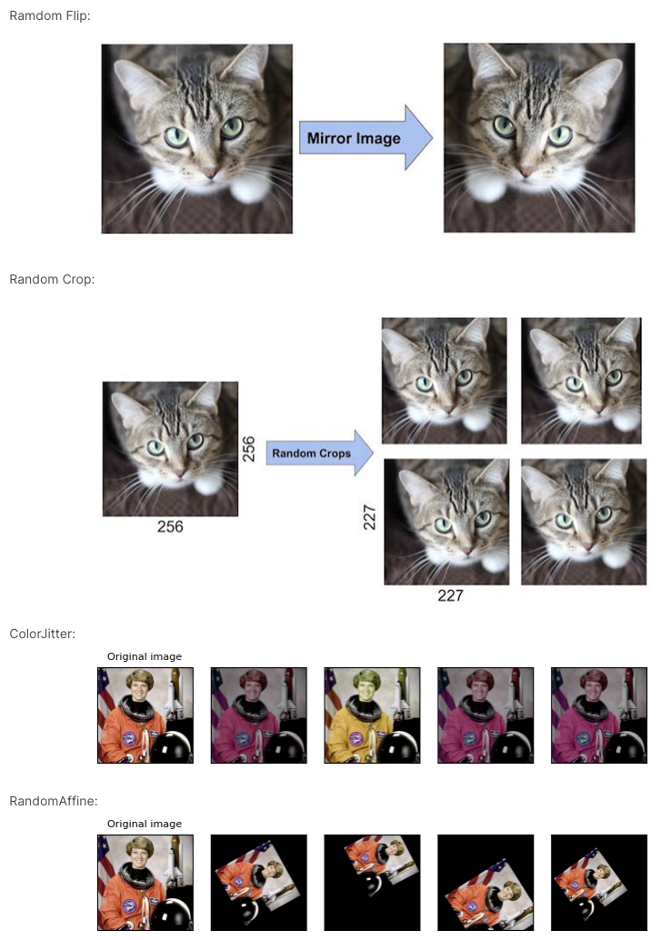
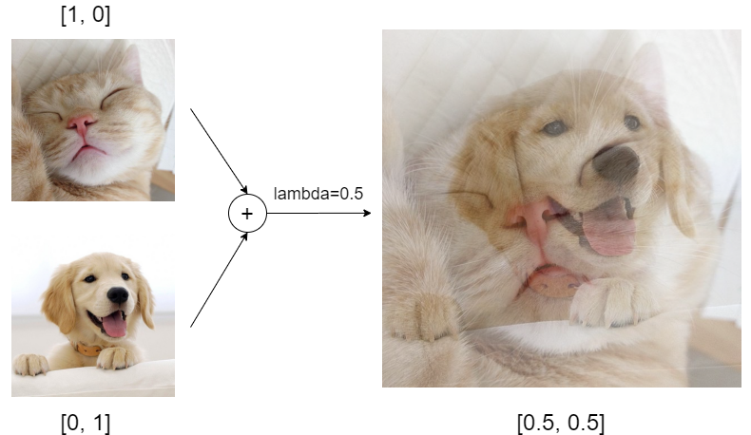
Swin Transformer with Image data:
Image data augmentation
Random flip/crop/affine, ColorJitter
MixUp
Notes:
It first splits an input RGB image into non-overlapping patches by a patch splitting module, like ViT. Each patch is treated as a “token” and its feature is set as a concatenation of the raw pixel RGB values. In our implementation, we use a patch size of 4 × 4 and thus the feature dimension of each patch is 4 × 4 × 3 = 48. A linear embedding layer is applied on this raw-valued feature to project it to an arbitrary dimension (denoted as C). Several Transformer blocks with modified self-attention computation (Swin Transformer blocks) are applied on these patch tokens. The Transformer blocks maintain the number of tokens ( H 4 × W 4 ), and together with the linear embedding are referred to as “Stage 1”.
To produce a hierarchical representation, the number of tokens is reduced by patch merging layers as the network gets deeper. The first patch merging layer concatenates the features of each group of 2 × 2 neighboring patches, and applies a linear layer on the 4C-dimensional concatenated features. This reduces the number of tokens by a multiple of 2×2 = 4 (2× downsampling of resolution), and the output dimension is set to 2C. Swin Transformer blocks are applied afterwards for feature transformation, with the resolution kept at H 8 × W 8 . This first block of patch merging and feature transformation is denoted as “Stage 2”. The procedure is repeated twice, as “Stage 3” and “Stage 4”, with output resolutions of H 16 × W 16 and H 32 × W 32 , respectively. These stages jointly produce a hierarchical representation,

Slide 22
Swin Transformer with Image data:
Model Training
LR scheduler: CosineAnnealingWarmRestarts
Optimizer: AdamW
AdamW yields better training loss, and the models generalize much better than models trained with Adam
Train loss: BCEWithLogitsLoss
If we directly use the output of the model as our predicted Pawpularity, then this value can be negative (which is not reasonable). However, if we use BCEWithLogitsLoss, its embedded Sigmoid function will transform the model output to [0,1], which is a reasonable region for Pawpularity Score (normalized by 100).
Max. epoch: 20
Five-fold Cross Validation
Notes:
It first splits an input RGB image into non-overlapping patches by a patch splitting module, like ViT. Each patch is treated as a “token” and its feature is set as a concatenation of the raw pixel RGB values. In our implementation, we use a patch size of 4 × 4 and thus the feature dimension of each patch is 4 × 4 × 3 = 48. A linear embedding layer is applied on this raw-valued feature to project it to an arbitrary dimension (denoted as C). Several Transformer blocks with modified self-attention computation (Swin Transformer blocks) are applied on these patch tokens. The Transformer blocks maintain the number of tokens ( H 4 × W 4 ), and together with the linear embedding are referred to as “Stage 1”.
To produce a hierarchical representation, the number of tokens is reduced by patch merging layers as the network gets deeper. The first patch merging layer concatenates the features of each group of 2 × 2 neighboring patches, and applies a linear layer on the 4C-dimensional concatenated features. This reduces the number of tokens by a multiple of 2×2 = 4 (2× downsampling of resolution), and the output dimension is set to 2C. Swin Transformer blocks are applied afterwards for feature transformation, with the resolution kept at H 8 × W 8 . This first block of patch merging and feature transformation is denoted as “Stage 2”. The procedure is repeated twice, as “Stage 3” and “Stage 4”, with output resolutions of H 16 × W 16 and H 32 × W 32 , respectively. These stages jointly produce a hierarchical representation,

Slide 23
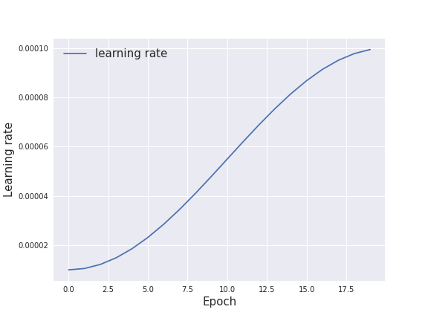
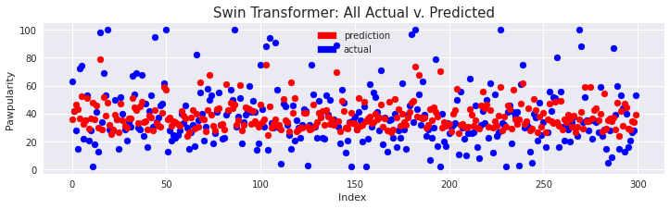
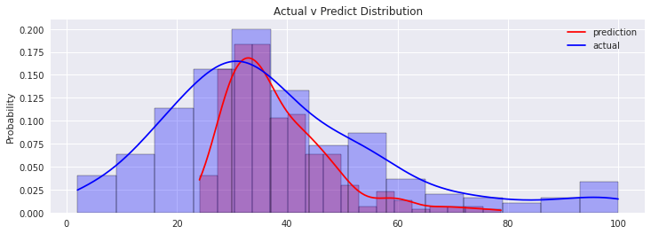
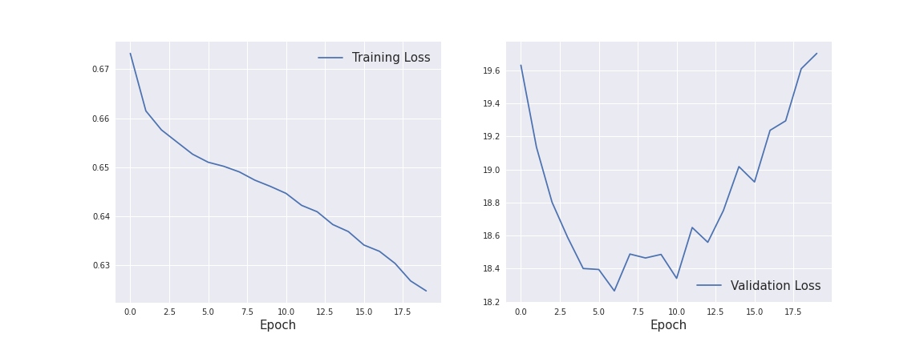
Swin Transformer with Image data:
Results: RMSE = 18.366 on Kaggle (1053/2260)
Learning rate
Prediction v.s. Acutual scores
Training & Validation loss
Notes:
It first splits an input RGB image into non-overlapping patches by a patch splitting module, like ViT. Each patch is treated as a “token” and its feature is set as a concatenation of the raw pixel RGB values. In our implementation, we use a patch size of 4 × 4 and thus the feature dimension of each patch is 4 × 4 × 3 = 48. A linear embedding layer is applied on this raw-valued feature to project it to an arbitrary dimension (denoted as C). Several Transformer blocks with modified self-attention computation (Swin Transformer blocks) are applied on these patch tokens. The Transformer blocks maintain the number of tokens ( H 4 × W 4 ), and together with the linear embedding are referred to as “Stage 1”.
To produce a hierarchical representation, the number of tokens is reduced by patch merging layers as the network gets deeper. The first patch merging layer concatenates the features of each group of 2 × 2 neighboring patches, and applies a linear layer on the 4C-dimensional concatenated features. This reduces the number of tokens by a multiple of 2×2 = 4 (2× downsampling of resolution), and the output dimension is set to 2C. Swin Transformer blocks are applied afterwards for feature transformation, with the resolution kept at H 8 × W 8 . This first block of patch merging and feature transformation is denoted as “Stage 2”. The procedure is repeated twice, as “Stage 3” and “Stage 4”, with output resolutions of H 16 × W 16 and H 32 × W 32 , respectively. These stages jointly produce a hierarchical representation,

Slide 24
Table of Contents:
Introduction
Dataset Description: PetFinder.my
Exploratory Data Analysis
Regression with Tabular metadata
Swin Transformer with Image data
Analysis

Slide 25
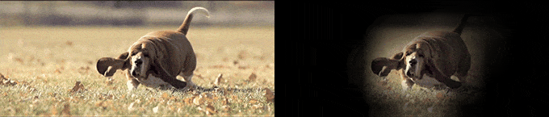
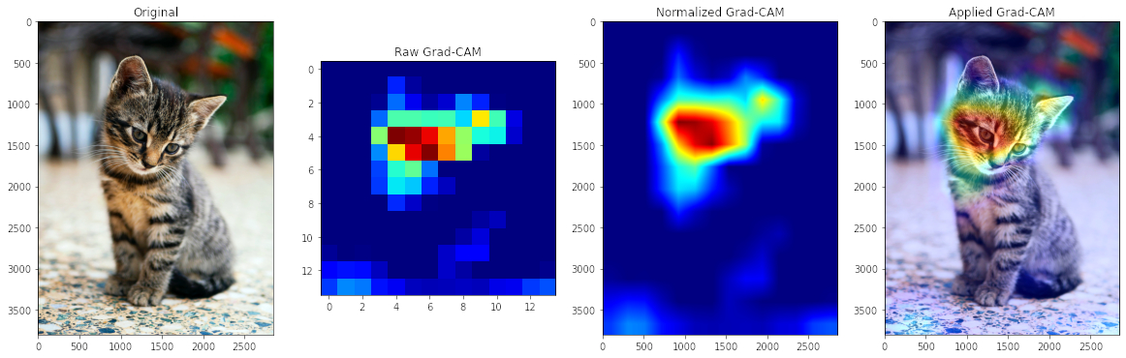
Analysis:
Grad-Cam:
While CNN enable superior performance, their lack of decomposability into intuitive and understandable components makes them hard to interpret.
Use the gradient information flowing into the last convolutional layer of the CNN to understand each neuron for a decision of interest.
Explain why they predict what they predict.
SwinT: model.layers[-1].blocks[-1].norm1
Notes:
The EDA suggests that most original features show weak correlation (absolute value < 0.1) with the response variable. In order to reduce the dimensionality, I conducted PCA analysis and extracted top 40 components which can explain about 80% of the data variance. Furthermore, 16 predictors with highest correlations were selected.

Slide 26
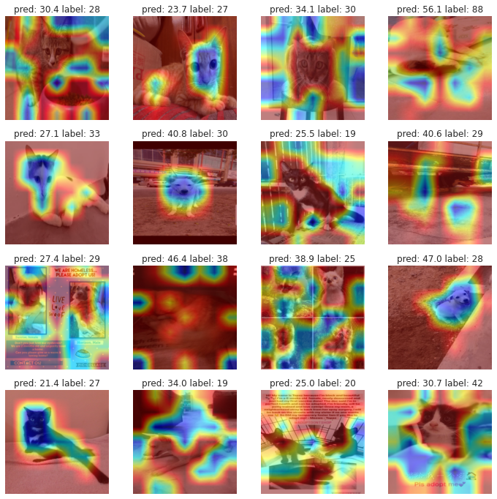
Analysis:
Grad-Cam:
Notes:
The EDA suggests that most original features show weak correlation (absolute value < 0.1) with the response variable. In order to reduce the dimensionality, I conducted PCA analysis and extracted top 40 components which can explain about 80% of the data variance. Furthermore, 16 predictors with highest correlations were selected.

Slide 27
Analysis:
Only two weak learners for the voting ensemble
Predictions based on image data are genuinely better than those based on tabular features
Methods integrating these two data sources may maximize their prediction power.
Notes:
The EDA suggests that most original features show weak correlation (absolute value < 0.1) with the response variable. In order to reduce the dimensionality, I conducted PCA analysis and extracted top 40 components which can explain about 80% of the data variance. Furthermore, 16 predictors with highest correlations were selected.

Slide 28
The end. Any question is welcomed!

